Slide 1
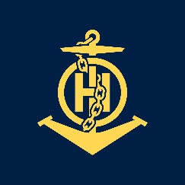
Competencies and experiences
IHO – NIPPON FOUNDATION
ALUMNI SEMINAR
Mrs. Olga Lucia BONFANTE Lozada
In team no challenge is very big

Slide 2
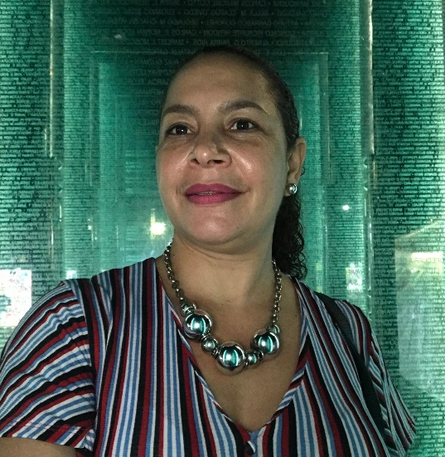
Self introduction
IHO – NIPPON FOUNDATION
ALUMNI SEMINAR
Name | Olga Lucia BONFANTE Lozada
Alumni year | 2012
Country | Colombia
Organization | Maritime General Directorate - DIMAR
Position/Job title | Head of Cartography
Current job description | coordinate, plan and validate the cartographic production. Supervise processes in general. Analysis and decision making in the area. Review documents of the OHI working groups. Lead projects

Slide 3
My career path and projects / Achievements
IHO – NIPPON FOUNDATION
ALUMNI SEMINAR
24 years in the HO Maritime General Directorate
2010 Prepared the ENC’s scheme. And I worked in the production and validation of ENCs
2012 Take Cat B course
2013-2015 Technical leader in the implementation process for cartographic production under Client-server HPD
2015 Head for the area of ​​cartography
2016 I began study to doctorate of sciences sea.
"METHODOLOGICAL PROPOSAL TO STANDARDIZE REGIONAL ELECTRONIC NAUTICAL CARTOGRAPHY SCHEMES - CASE STUDY: CARIBBEAN SEA"

Slide 4
My career path and projects / Achievements
IHO – NIPPON FOUNDATION
ALUMNI SEMINAR
Technical leader of the Bilateral Cooperation Agreements of the Maritime Directorate General (DIMAR), with the UKHO UK Hydrographic Office and with the International Center for ENCs (IC-ENC)
2017 Implement Proyecto MSDI,
Migration of the production paper chart format to the DB HPD system.
Supporting the process of implementation and technology transfer for cartographer staff to the new production systems.

Slide 5
Lessons learned from CHART Course
IHO – NIPPON FOUNDATION
ALUMNI SEMINAR
Stick to the standards, letting cartographers know the relevance of using them to represent correctly.
Importance of representing the contours demonstrating the real shape of the seabed.
Evaluate the information and bathymetric quality to use in products.
Implement formats to compile and evaluate data sources for products (paper chart and ENCs), improve the way to review nautical charts.

Slide 6
Suggestion for the future
IHO – NIPPON FOUNDATION
ALUMNI SEMINAR
The training includes Knowing the operation and status of commercial tools (ESRI, CARIS, dKart, 7Cs) generation of products according to standards S-100, S-101, S-102
Highlight the importance of writing about the technical work being developed.

